Slide 1

Server Under the Mountain (SUM)
Notes:
Alex

Slide 2

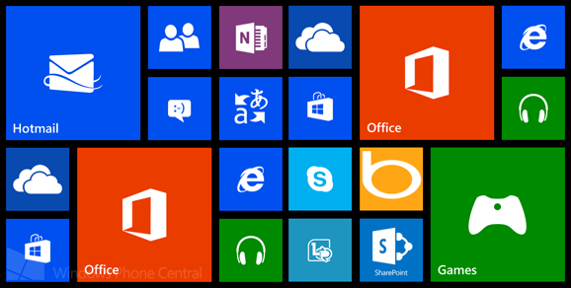
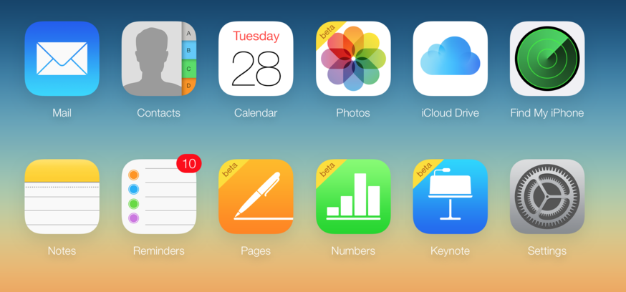
Problem
When you receive a free product then you usually are the product. Most companies track user behavior and collect personal information as part of their business model. User privacy continues to be a concern and individuals do not have the right tools to take complete control of their personal data.
Your most private data including notes, account information, and task lists are stored by major companies who can access the information any time.
Notes:
Alex

Slide 3
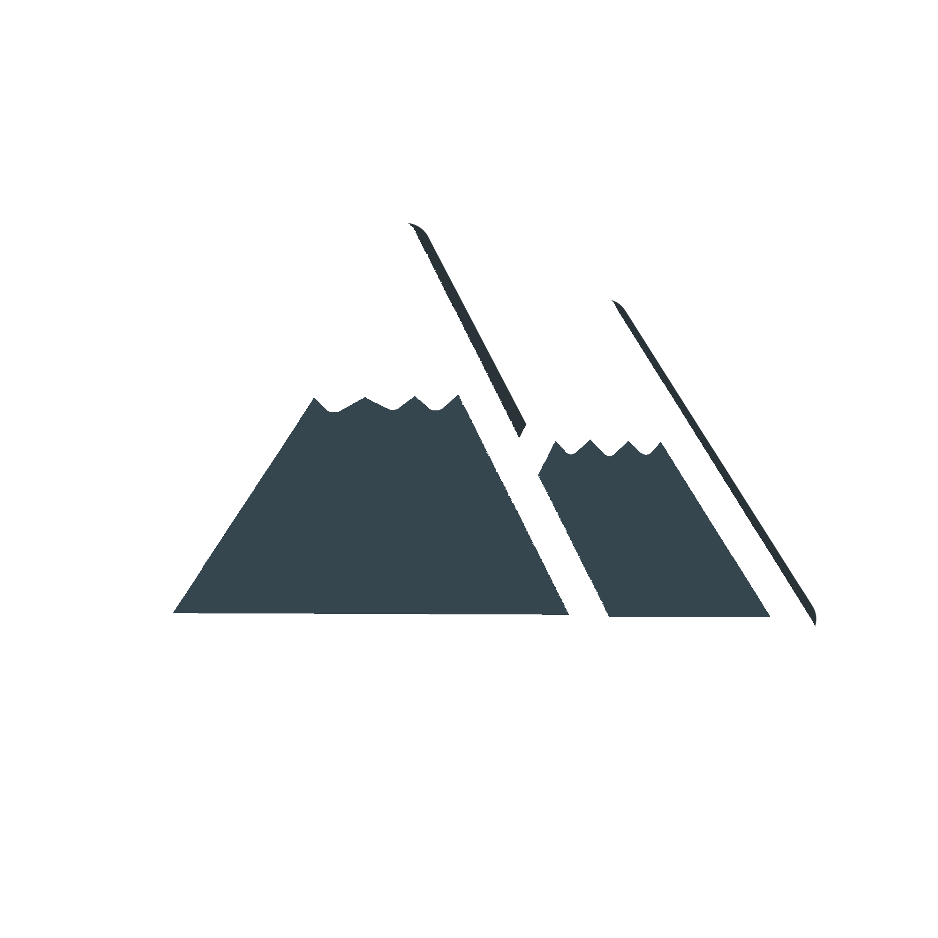
Notes
Passwords
Server Under the Mountain (SUM)
Open source solution for managing a private, secure, and highly scalable data repository.
Notes:
Luke - “ SUM offers resources on privacy practices, developer libraries for utilizing security features, and a suite of applications to replace the ‘big name’ company applications “

Slide 4
Security
Take Control Of Your Personal Data
Data never leaves your device without your permission, all notes and passwords are exclusively local.
Easy & Secure Backups
For when life’s accidents happen, you can rest assured that your data is available only to you.
Store encrypted backups on any cloud while keeping your data locked behind a master password.
Notes:
Collin

Slide 5
Additional Features
Free & Open Source
Peer reviewed code, security nerds approve.
Minimal Footprint
No bloatware, no ads, no trackers.
Incognito Mode
Blocks screenshots and hide content when you switch between apps.
Quick Search
Use #Hashtags, words, or phrases to find a note.
Notes:
Jessica, Michael (3 each)

Slide 6
End of Proposal
Up Next: Roadmap & Sprint Planning →

Slide 7
Server Under the Mountain (SUM)
Roadmap & Sprint Planning

Slide 8
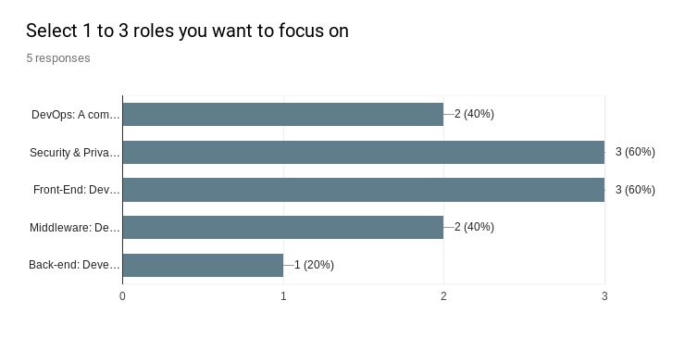
Notes:
The team completed a survey to see generally what each person is interested in. We have a pretty good spread of interests that cover all of our project’s requirements.

Slide 9
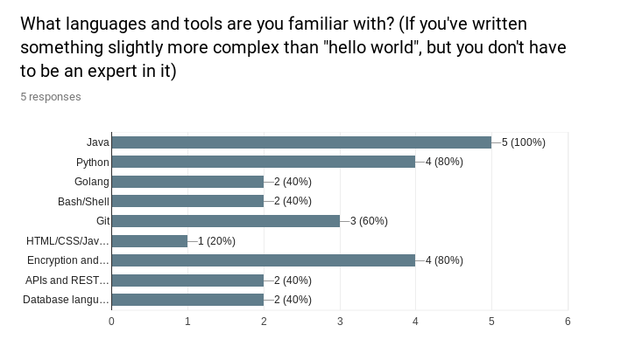
Notes:
In the survey we also tried to get a baseline of what experience our team has.

Slide 10
Primary Roles
Alex | Full Stack & Cross-Platform Developer
Collin | Architecture Lead, Full Stack & Cross-Platform Developer
Michael | Web Developer, Release Lead
Luke | Project Manager, Scrum Master, Android Developer
Jessica | Security Architect, Threat Analysis Documentor, Android Developer
Notes:
From the survey we started to delegate tasks based on primary roles. Everybody will get a taste for different parts of the project, this is just an overview of what each person will focus on.

Slide 11
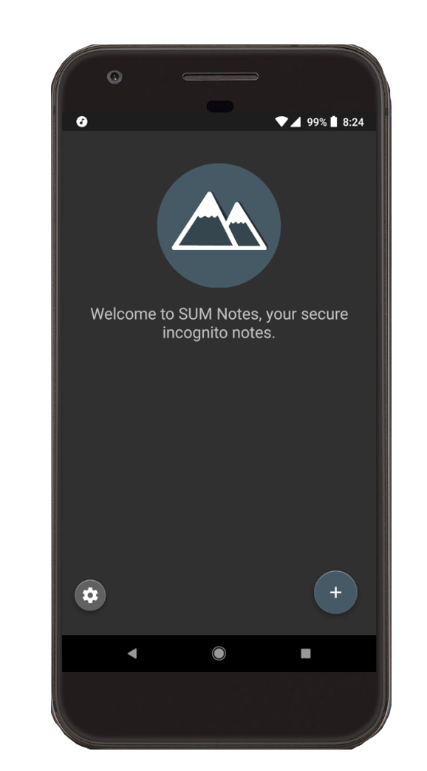
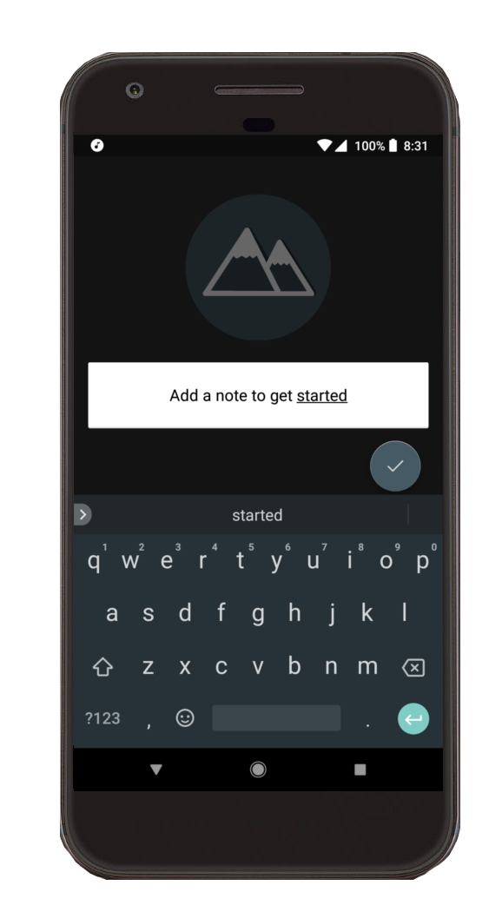
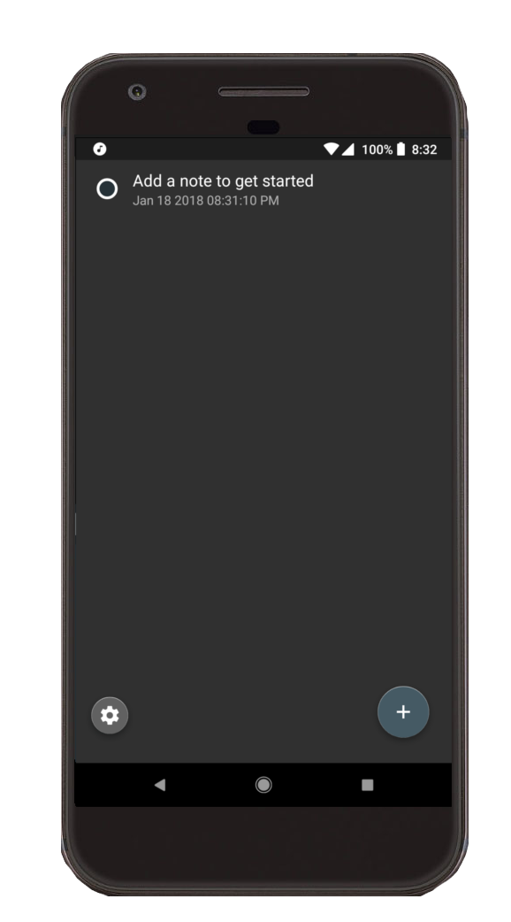
SUM Notes - Built for short thoughts and long markdown documents.
Proof of Concept for supporting mobile devices on our cross-platform software suite.
Notes:
Luke’s additional slide - “ Here’s a working proof of concept for our secure notes app. The interface keeps things simple and accommodates a range of use cases, from quick notes to extensive markdown documents. All of this currently works and has an optional server side for backups.” ---- NOTE that “level 0 and level 1 security options” is explained next in Collin’s slide

Slide 12
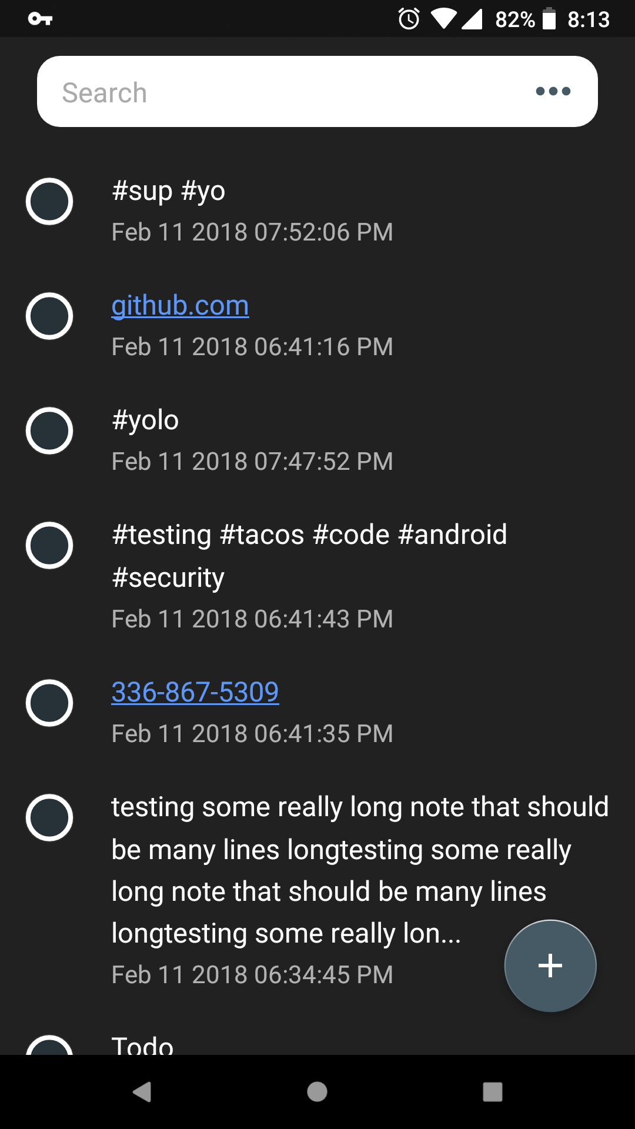
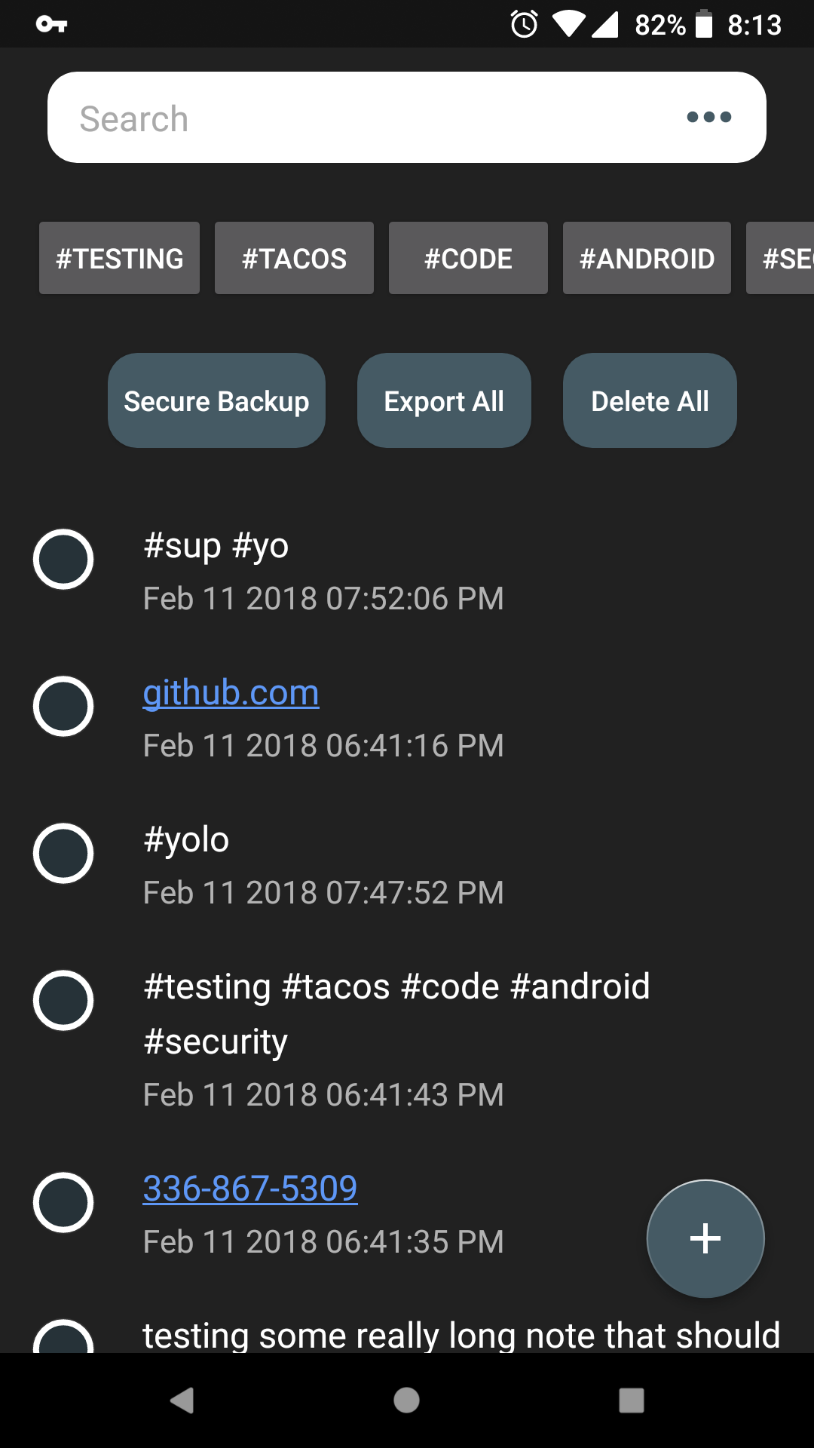
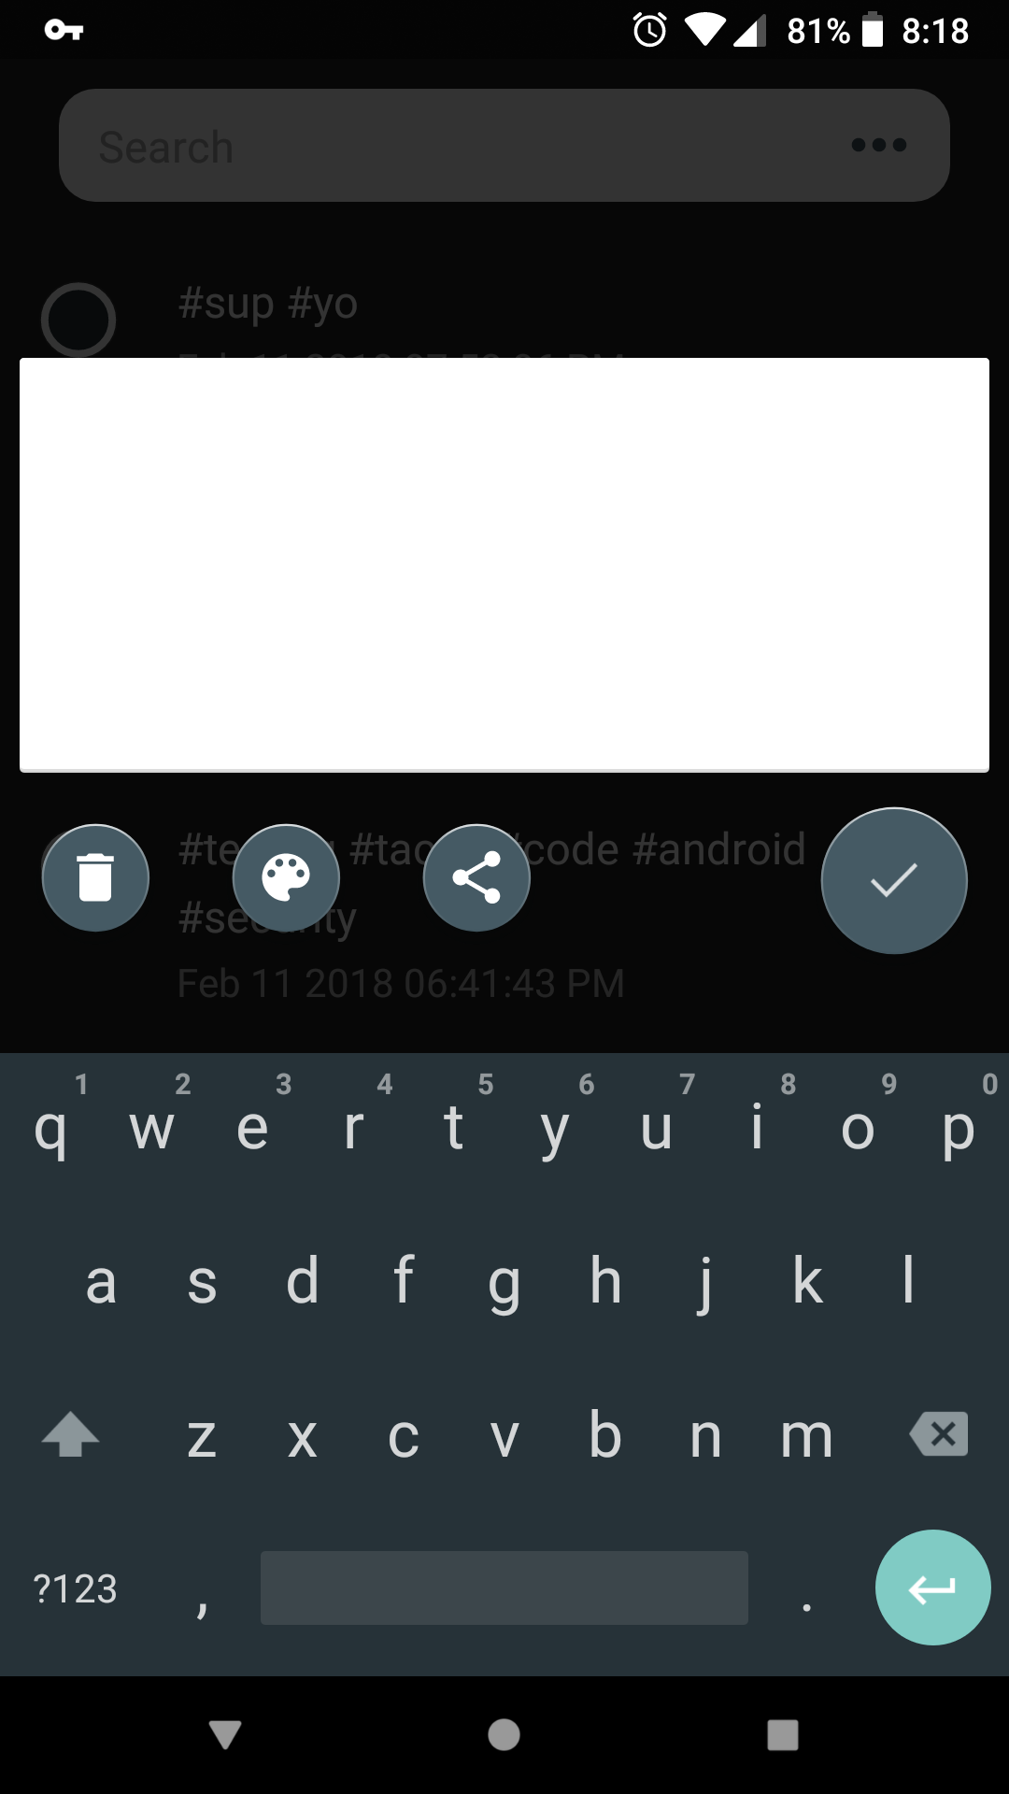
SUM Notes - Progress
Automatically creates links for urls, phone numbers, email addresses, map addresses, and tags.
Ability to search through notes
Tap a tag below the search bar to show all notes with the same tag
Support for short notes and long lists
Blocks other apps from acquiring screen content, blocks screenshots, uses API to request incognito mode for keyboard
Option to export all data to another app that accepts strings or quick purge of all data
Notes:
Collin

Slide 13
Web Presence
Create a splash page that explains what SUM is and what we have to offer. This is served in the GitHub repo and requires no hosting or maintenance.
Getting started - Jekyll
Create a repository on GitHub and use one of their “GitHub Pages Templates” as an initial version.
Customize the template, theme it, add logo, and start writing marketing content that tells users what we have to offer.
Notes:
Jessica

Slide 14
End of Roadmap & Sprint Planning
Up Next: Requirements -->

Slide 15
Server Under the Mountain (SUM)
Requirements

Slide 16
Problem
When you receive a free product then you usually are the product. Most companies track user behavior and collect personal information as part of their business model. User privacy continues to be a concern and individuals do not have the right tools to take complete control of their personal data.
Your most private data including notes, account information, and task lists are stored by major companies who can access the information any time.
Notes:
Alex

Slide 17
Requirements
Functional
Front-end application for input of Note content
Locally encrypted database
Read/Write locally encrypted database by entering the encryption password
Usability
Minimalistic layout and controls designed for the average user
Technical functionality is available for more experienced users
Public webpage with all privacy and security policies outlined for users
Notes:
Denney

Slide 18
Requirements
System
Hardware: Mobile Device
Software: Android Operating System
Database: NoSQL DB (encrypted)
Privacy & Security
Block other apps from acquiring screen content
Block screenshots
Requests incognito mode from system keyboard
NoSQL database (AES 256 encrypted)
All data stays encrypted locally unless you use the export tool
Notes:
Michael

Slide 19
Subsystems
Encryption Subsystem
AES encryption
AES decryption
File Management Subsystem
Add, edit, delete notes
Broad data actions (eg. delete all)
Search Management Subsystem
Search by tag: use a regular expression to parse hashtags in notes for categorical grouping
Search by phrase: raw string searching
Notes:
Luke
AES Encryption/Decryption
File management
Search Management
Broad Data Actions (i.e. Delete All)
Import/Export of encrypted data files
User Interface & User Experience Design

Slide 20
Subsystems
Import & Export Subsystem
Local Storage: Reference offline files
Cloud Storage: References backups stored on different cloud services
UI & UX Subsystem
Android app
Notes:
AES Encryption/Decryption
File management
Search Management
Broad Data Actions (i.e. Delete All)
Tag filtering
Import/Export of encrypted data files
User Interface & User Experience Design

Slide 21
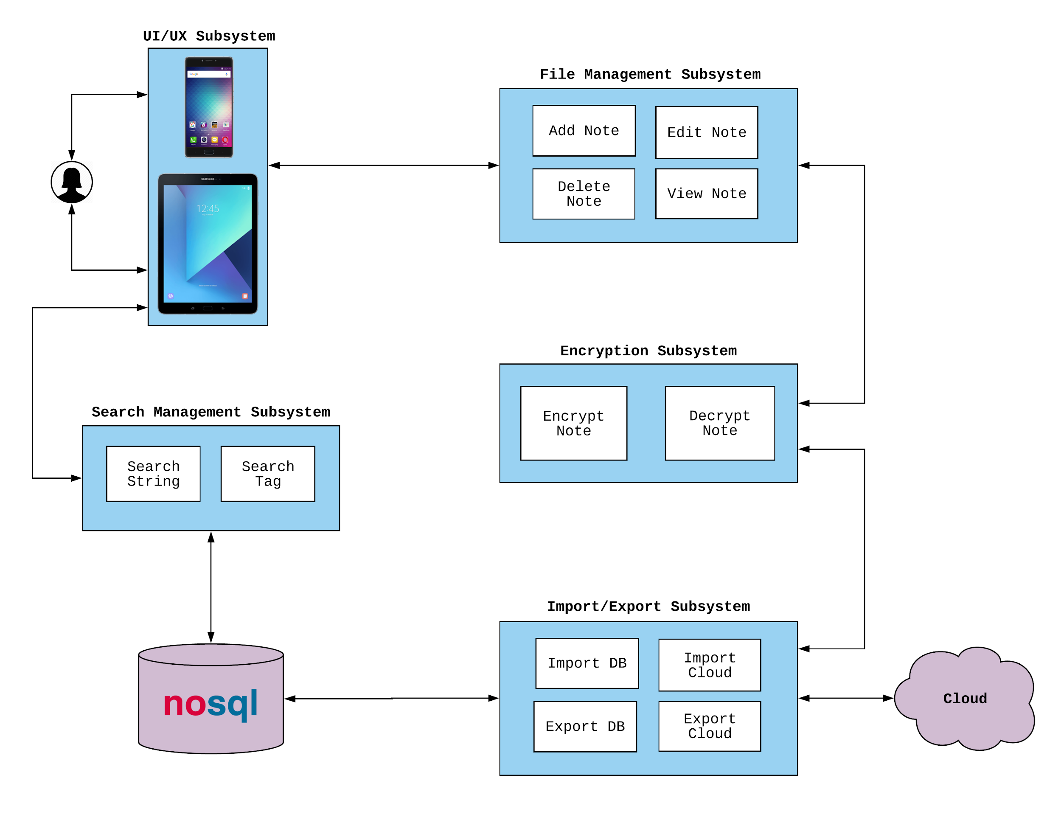
Subsystems

Slide 22
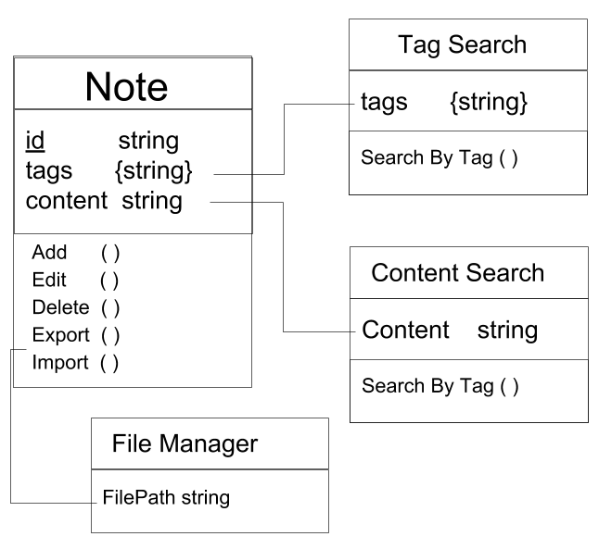
ER Model

Slide 23
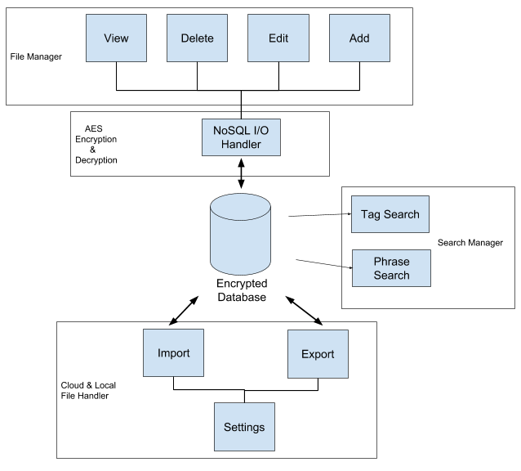
Subsystem Communication

Slide 24
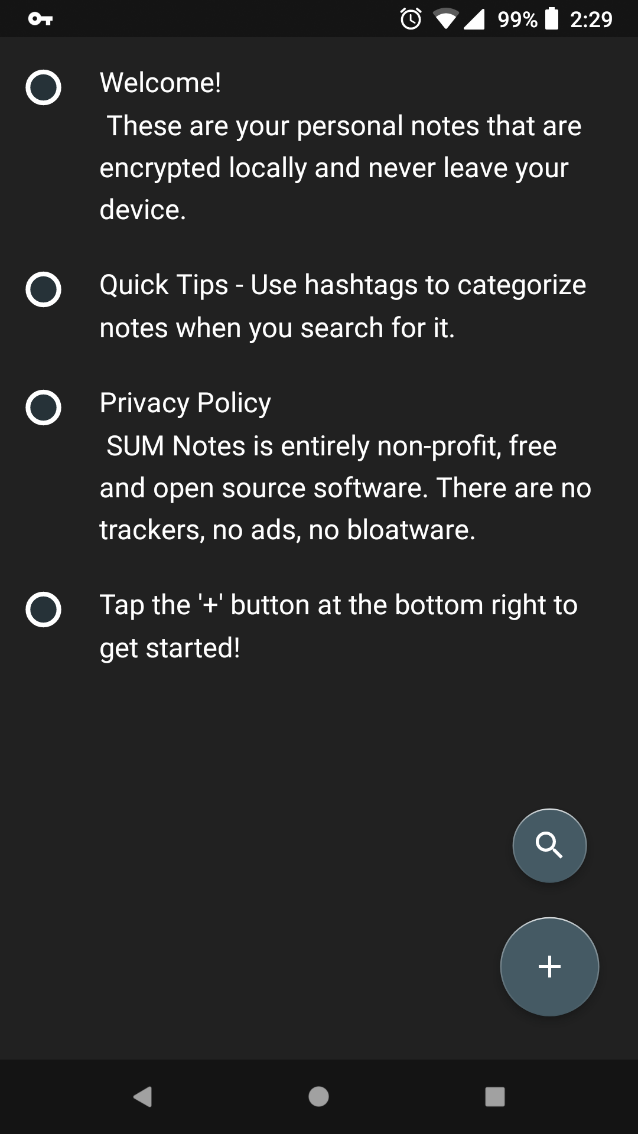
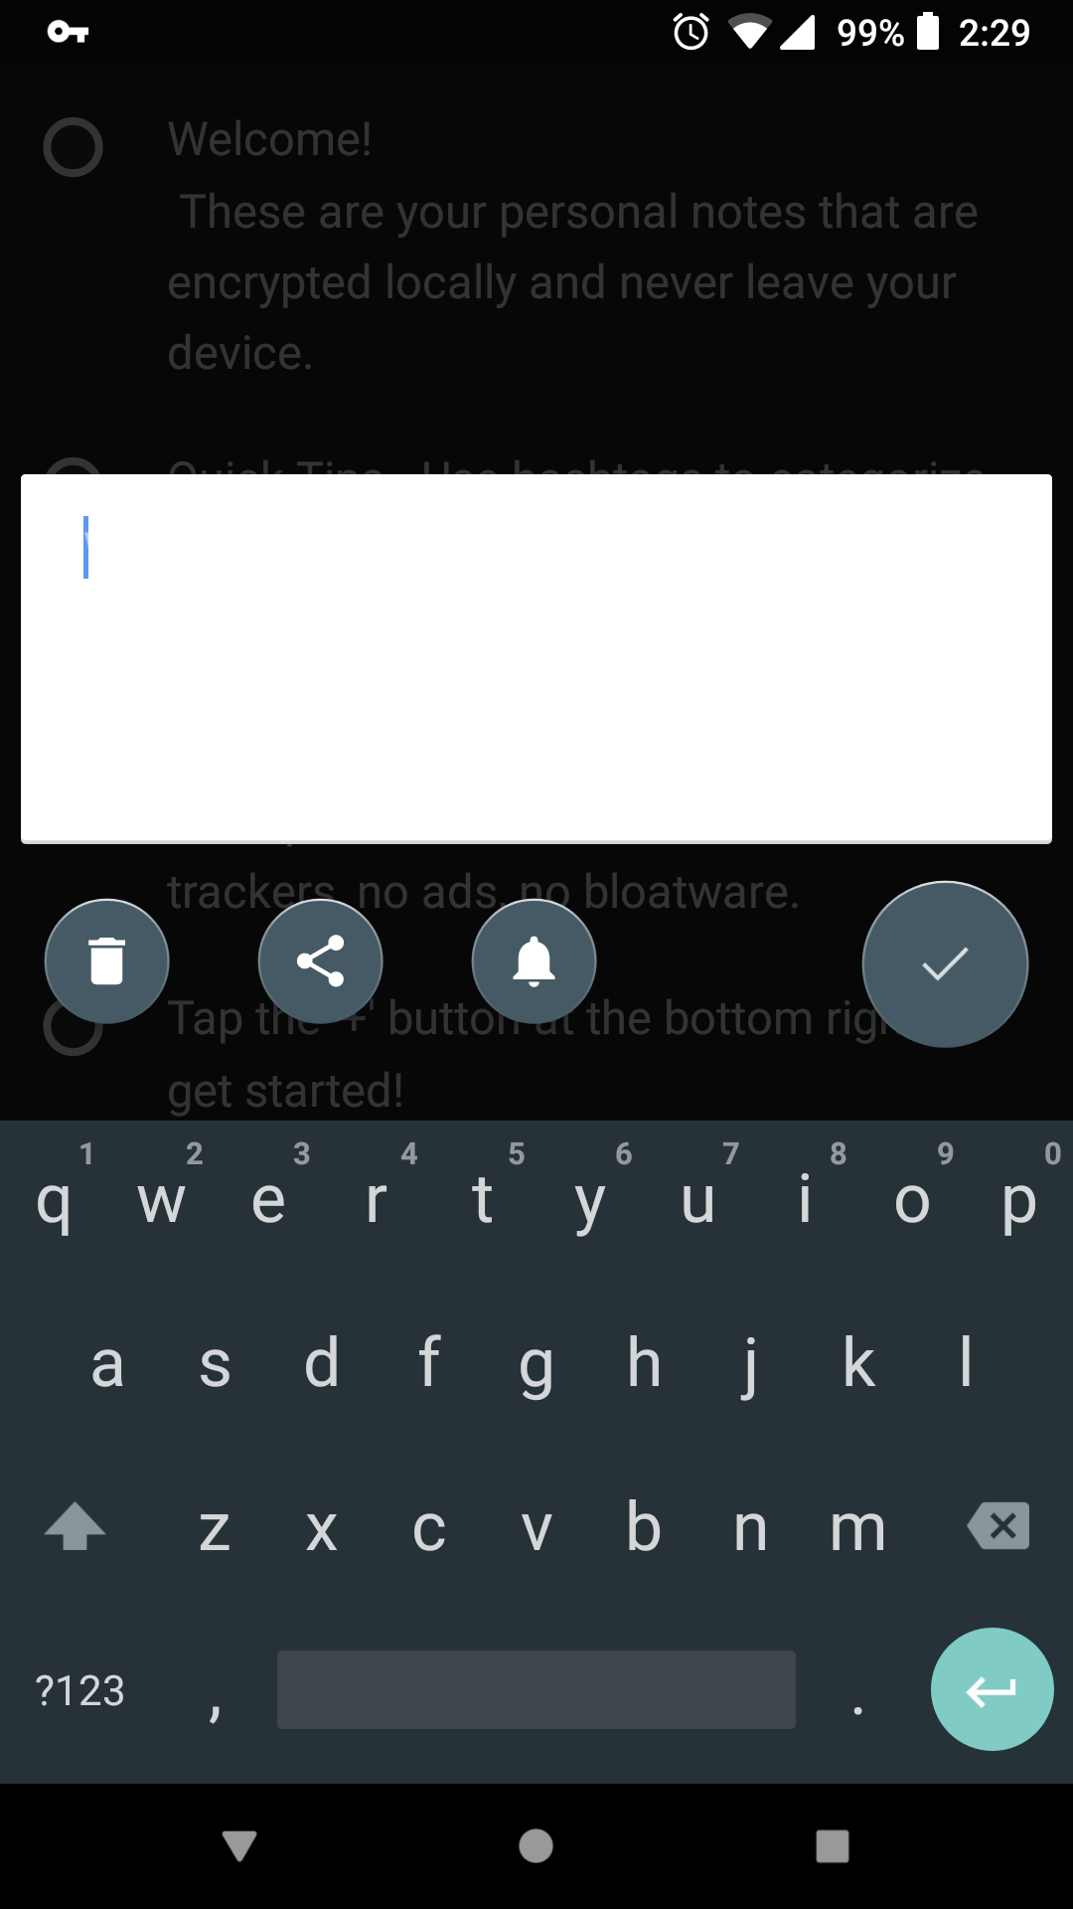
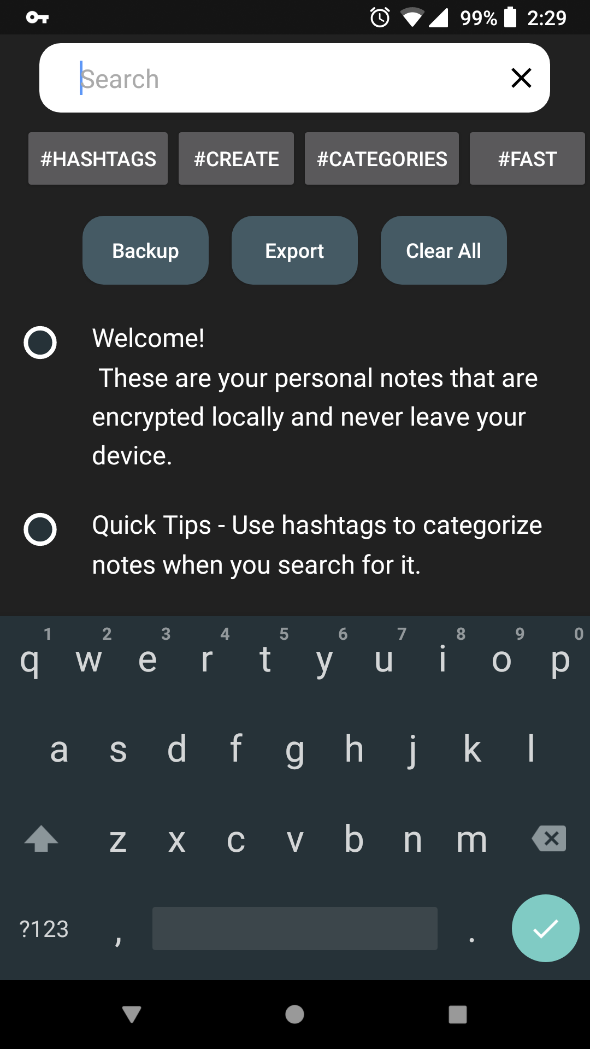
User Flow
Download the app from the Google Play Store and open it
Learn about the privacy policy and security features by reading the default notes
Enter personal note content
Notes:
Collin

Slide 25
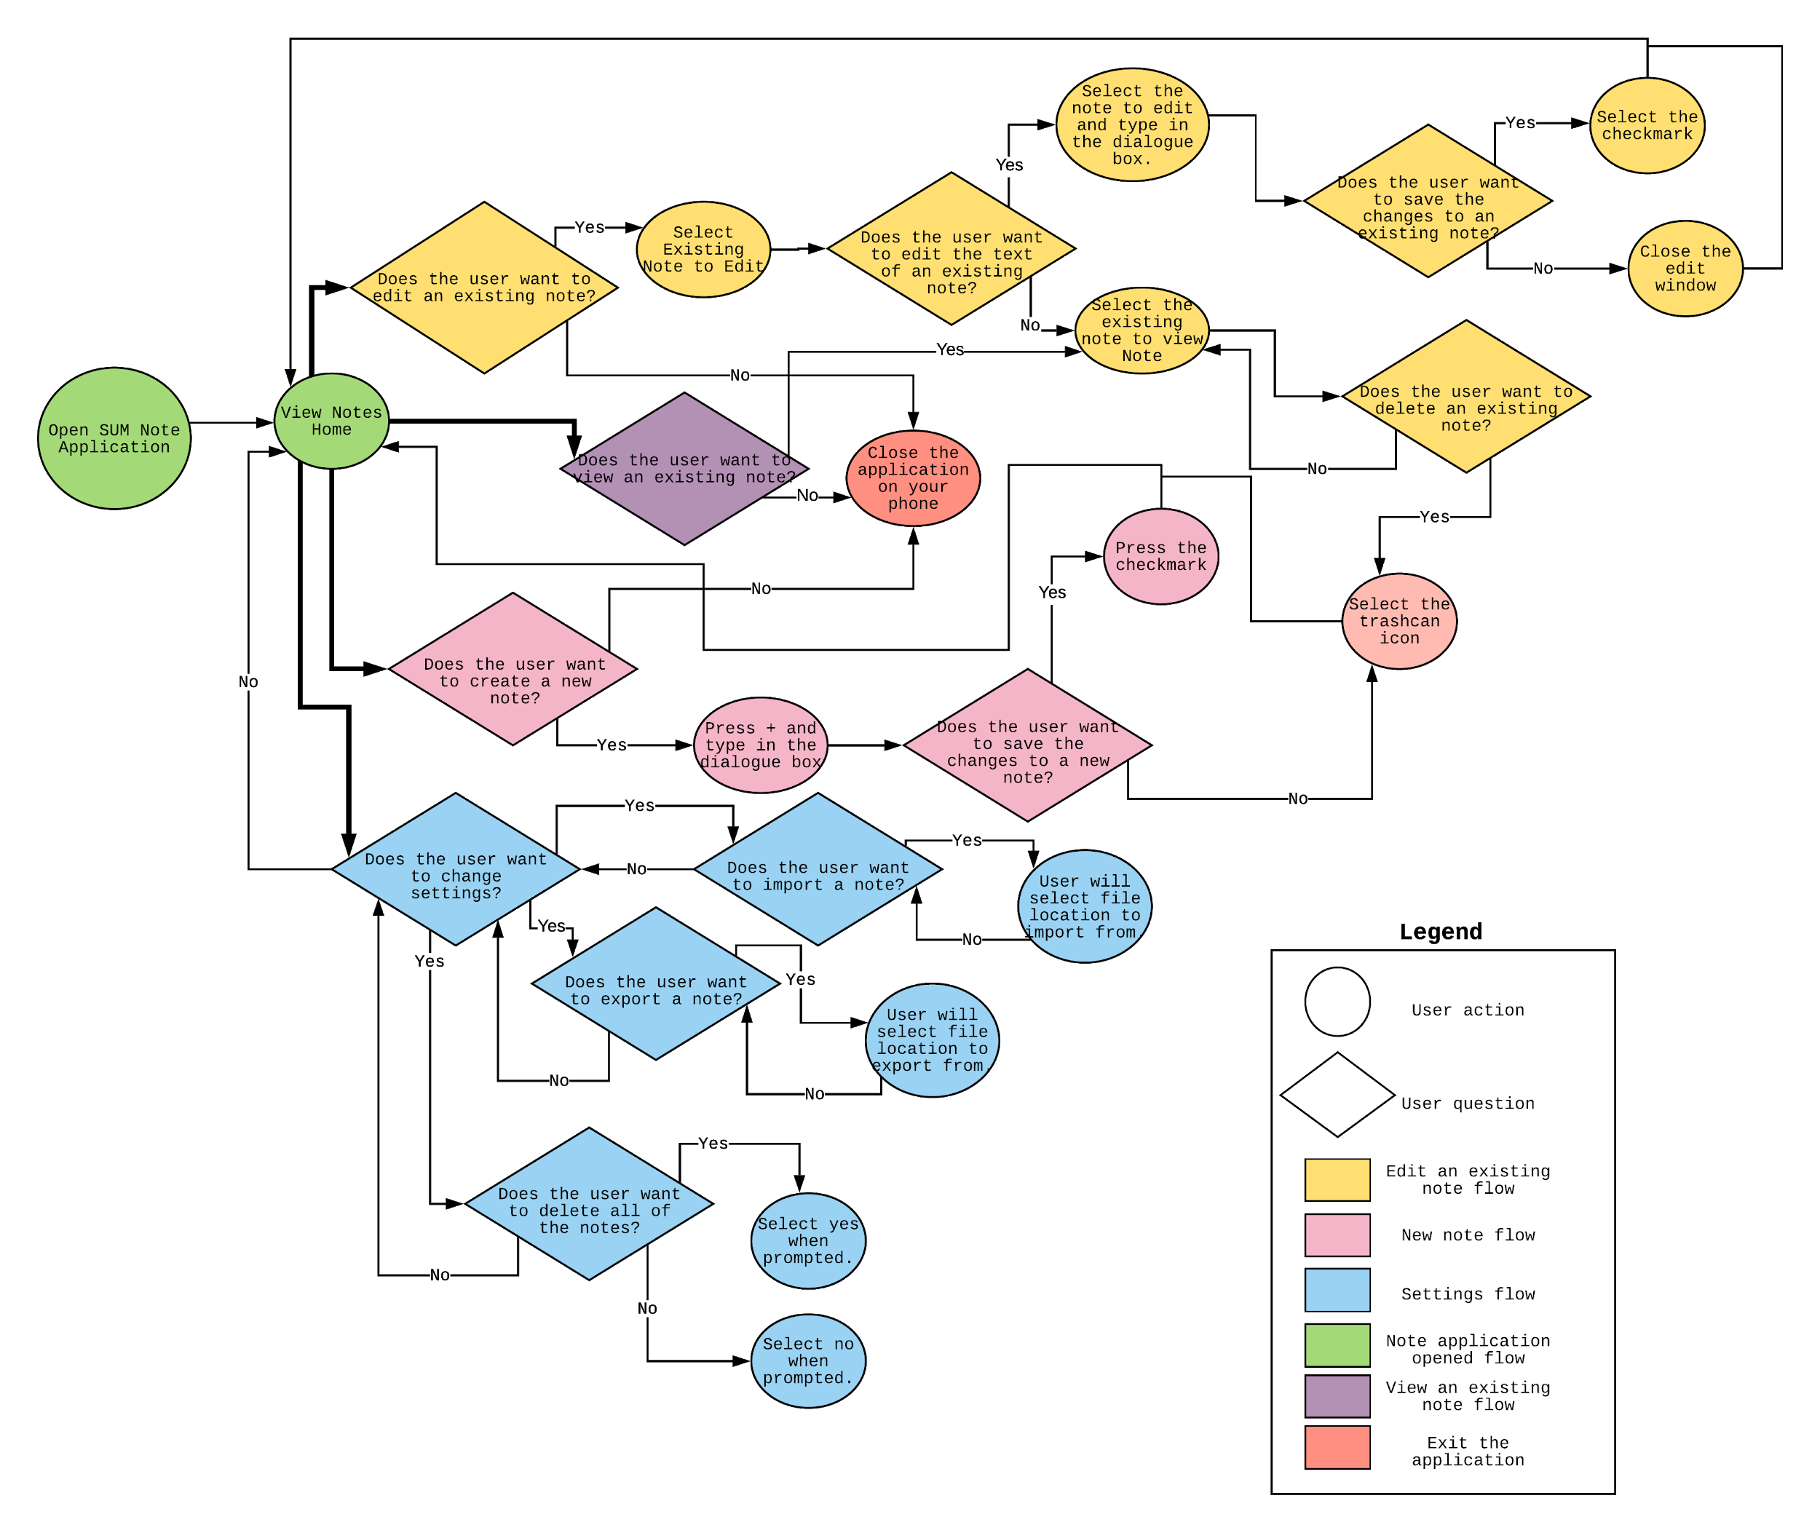
User Flow

Slide 26
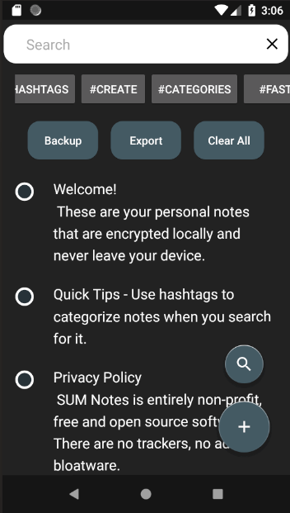
Detailed Design and Controls
Closes search bar and commands
Lets the user search by string or hashtag
Direct way to search by available hashtags
Opens search bar and commands
Quick commands for all data
Opens new note editor
A note. This one is preloaded as a user guide
Notes:
Luke

Slide 27
Data Dictionary
One primary object that’s stored in an encrypted database: Note (long id, string content, string tags)
Table Structure | CREATE TABLE NOTES ( _ID INTEGER PRIMARY KEY AUTOINCREMENT, CONTENT TEXT, TAGS TEXT)
Add Note | INSERT INTO NOTES ( CONTENT , TAGS )
Update Note | UPDATE NOTES SET ( CONTENT, TAGS ) WHERE _ID = X
Remove Note | DELETE FROM NOTES WHERE _ID = X

Slide 28
Algorithm Analysis
Loading encrypted data: NoSQL.decodeDBFile(<pw>)
Writing encrypted data: NoSQL.add(<string>)
Importing data files: Small text strings, not resource intensive
Parsing tags: Search newly inserted note content for hashtags using regex and store the list with references to the row ID - O(n) for string length
Notes:
Collin

Slide 29
(Optional) Cloud Services
Cloud services can use utilized to provide easy storage of data. Since it’s encrypted using a password that only you know, the cloud storage provider has zero knowledge of your data.
Pick any cloud provider service
The cloud provider must be on the device
Uses built in Android feature to copy data from one app to another
Data will be encrypted before being copied to other apps
All data will be locked behind the user’s password
Notes:
Denney

Slide 30
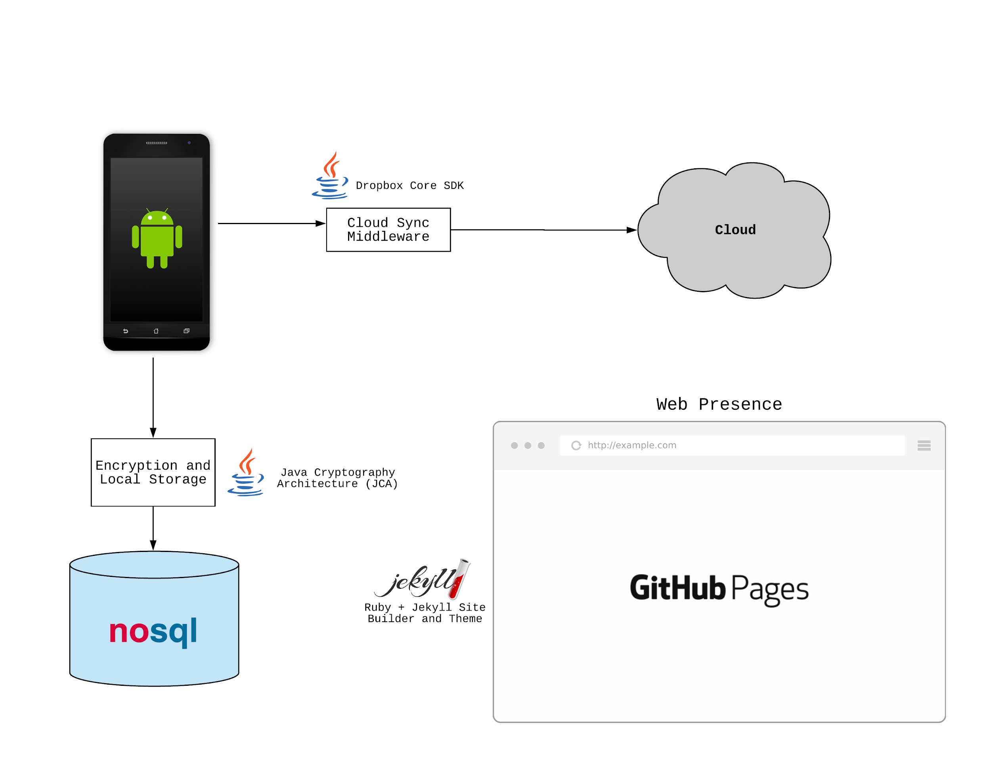
Architecture

Slide 31
End of Requirements
Up Next: Scrum Report →

Slide 32
Server Under the Mountain (SUM)
Scrum Report
Notes:
Luke Pitch

Slide 33
Problem
When you receive a free product then you usually are the product. Most companies track user behavior and collect personal information as part of their business model. User privacy continues to be a concern and individuals do not have the right tools to take complete control of their personal data.
Your most private data including notes, account information, and task lists are stored by major companies who can access the information any time.
Notes:
Alex

Slide 34
Sub-System Communication
Notes:
Collin

Slide 35
Sprint Roadmap (2 week sprints)
1 (1/22 - 2/2) | Basic Notes App - (Collin, Alex, Jessica, Michael, Luke) Local storage No encryption Add notes Edit notes Delete notes
2 (2/5 - 2/16) | Encryption/Decryption - (Collin, Alex, Jessica) Encrypt with AES Decrypt with AES Searching/Tag Filtering - (Collin, Luke, Michael) Add tags to notes Removes tags Search for a tag Select a tag
3 (2/19 - 3/2) | Security - (Jessica, Collin) Master password to access secure notes file Cloud Sync - (Alex, Luke) Send encrypted notes to cloud storage Web Presence - (Michael) Information detailing… Security in the app Privacy policies Functionality and instructions
Notes:
Alex
Don’t go into too much detail on this. Basically we’re prioritizing the “SUM Notes” app, making sure it’s secure at the ground level in addition to offering a secure cloud backup option. We’ll see how these sprints turn out… it wouldn’t be smart to plan too far out since we’re in the early stage of being a team.

Slide 36
Sprint Roadmap (2 week sprints)
See More on our GitHub page
4 (3/12 - 3/23) | Password Manager - (Collin, Luke, Jessica, Michael, Alex) Add passwords Edit passwords Delete passwords Copy/autofill password to another application for login
5 (3/26 - 4/6) | Security Audit - (Collin, Luke, Jessica) Detail flow of information Detail security measures Web Presence 2.0 - (Michael, Alex) Information detailing... Storage of password data Functionality and instructions
Notes:
Collin, then Denney
CODE LOCK: 4/6 (Final Project)
Focus all work on final presentation and supporting documents 4/9 - 4/13
Don’t go into too much detail on this. Basically we’re prioritizing the “SUM Notes” app, making sure it’s secure at the ground level in addition to offering a secure cloud backup option. We’ll see how these sprints turn out… it wouldn’t be smart to plan too far out since we’re in the early stage of being a team.

Slide 37
End of Scrum Report

Slide 38
Server Under the Mountain (SUM)
Scrum Report 3/19

Slide 39
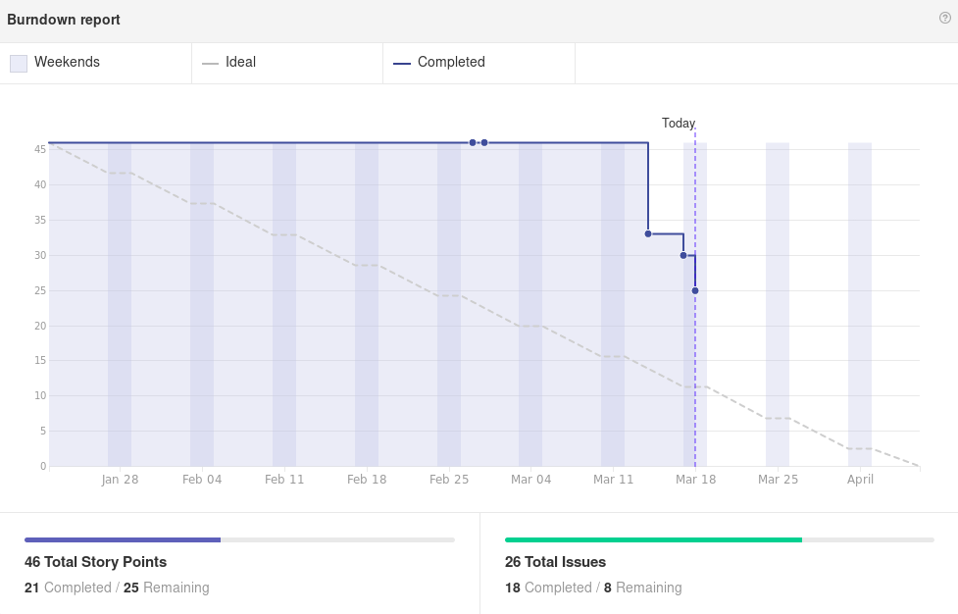

Slide 40
Alex
Worked on:
Import/Export Subsystem
Began work on cloud sync
Issue #15: As a user I want to backup my notes
This Sprint:
Finish cloud sync implementation
Android Share Intent

Slide 41

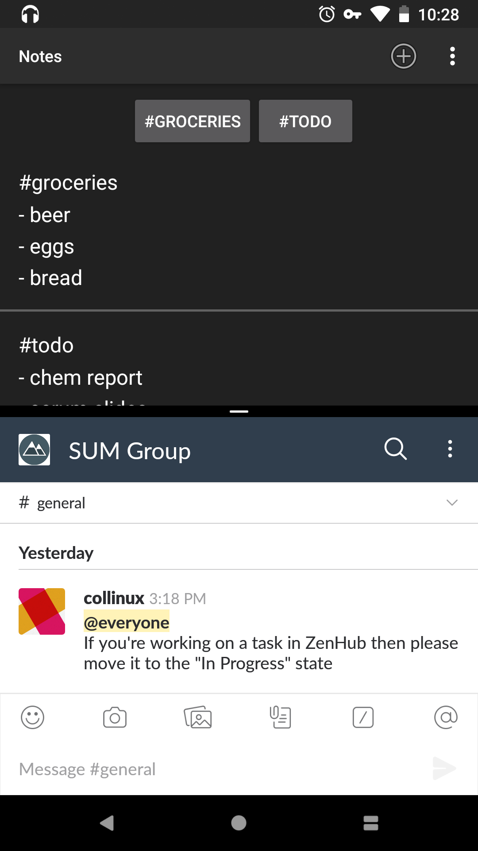
Collin
Worked On
Redesign of logo
Tag Parsing: All #hashtags dynamically parsed on startup, when a note is edited, and when a note is deleted.
Support for split view mode
Highlight text in any other app to share it with SUM Notes
This Sprint
Ability to set a master password on first startup and prompt for passphrase each time the app opens. (started last sprint)
Design of password storage interface

Slide 42
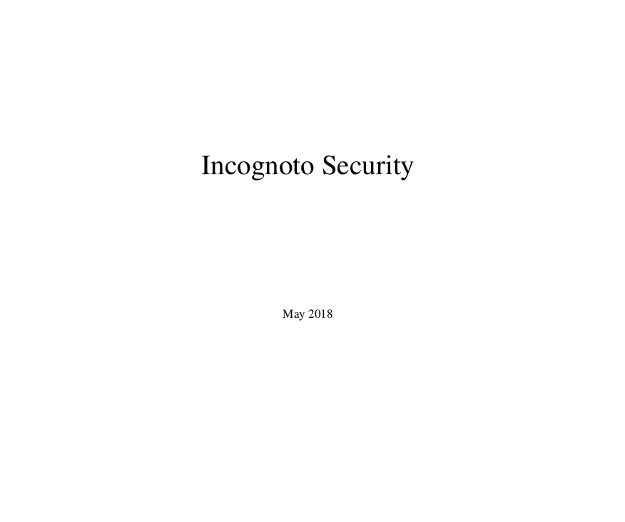
Jessica
Worked on:
User Security Policy
Terms of Service
Privacy Policy
Issues:
As a user I want to understand the privacy and security policies before I install the app
This Sprint:
Researching and implementing a biometric option for decryption
Finishing security documentation
User Manual

Slide 43
Luke
Worked on:
Duplicate Note Filtering
Failed and then back end database changed
SearchManager
Issues:
As a user, I want to avoid having duplicate notes - 3
As a user, I want to search for notes containing word(s) - 5
This Sprint:
Continuing SearchManager
Issues:
As a user, I want to search for notes containing word(s) - 5

Slide 44
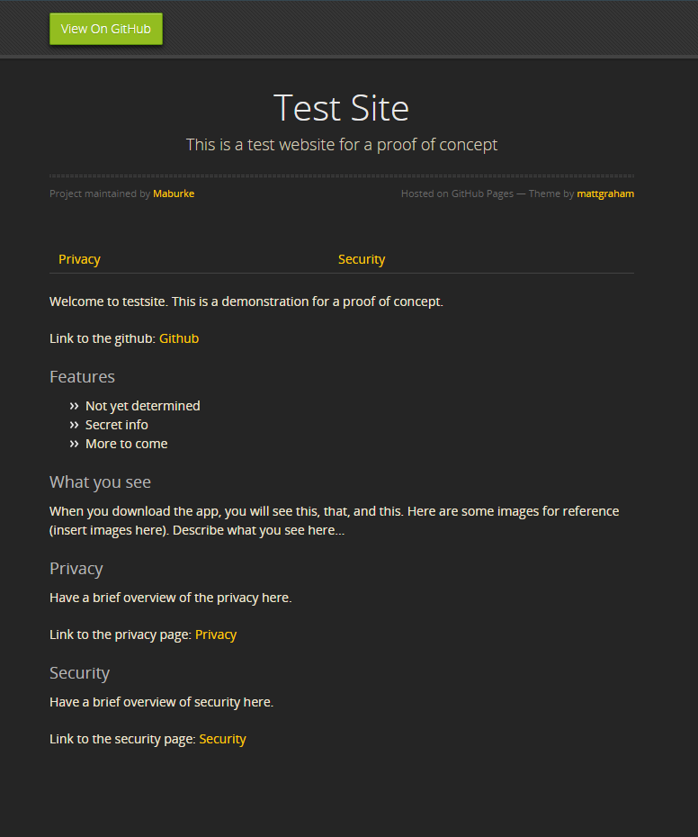
Michael
Worked on:
POC for our website
Researched how to work with Github Pages
Researched Github flavored markdown
https://maburke.github.io/test-website/
This Sprint:
Help work on Privacy and Security Policies
Setting up our website for the notes app

Slide 45
Server Under the Mountain (SUM)
Scrum Report 3/26

Slide 46
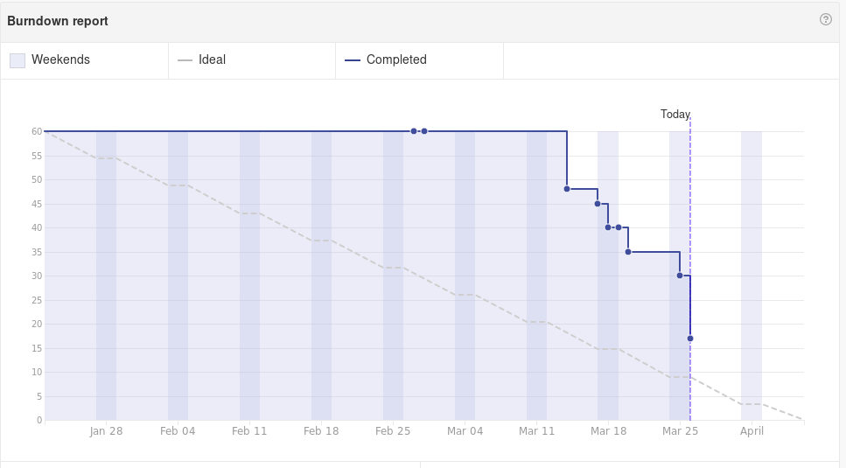

Slide 47
Alex
Worked on:
Import/Export Subsystem
Issue #15: As a user I want to backup my notes (7 points)
Continued work on cloud sync
The app is able to initiate the Intent to share content
BUT, the receiving end is not receiving properly
We may have to switch to using the Dropbox Core API
This Sprint:
Finish cloud sync functionality

Slide 48
Collin
Worked On
Use a YubiKey NEO as a hardware authentication method (5)
Password generated on startup (3)
Ability to change password (3)
Front end for search input (3)
This Sprint
UI picker for authentication methods
Ability to restore notes from a backup

Slide 49

Jessica
Worked on:
Continued Work on User Security Policy
Terms of Service
Privacy Policy
Issues:
As a user I want to understand the privacy and security policies before I install the app(5)
This Sprint:
Researching and implementing a biometric option for decryption(5)
Finishing security documentation
User Manual

Slide 50
Michael
Worked on:
Added default notes (Welcome, features, security/privacy) ( 2)
Added to future website (1)
Duplicate tags(needs to be continued) (3)
This Sprint:
Duplicate tags(3)
Improve change password interface and check for valid input(3)

Slide 51
Luke
Worked on:
SearchManager
As a user, I want to search for notes containing word(s) (5)
This Sprint:
SearchManager
I want to be able to search for notes containing a term (7)
I want to be able to search for notes containing two terms (3)

